Slide 1
Cardiovascular Risk Prediction
CAPSTONE PROJECT
Presented By:
Student Name- Adarsh Agrawal
College Name- Shri G.S. Institute of Technology and Science
Department- Information Technology
Mob- 8815992486
Email- adarshagrawalSGSITS@gmail.com

Slide 2
OUTLINE
Problem Statement
Proposed System/Solution
System Development Approach
Algorithm & Deployment
Result
Conclusion
Future Scope
References

Slide 3
Problem Statement
The dataset is from an ongoing cardiovascular study on residents of the town of Framingham, Massachusetts. The classification goal is to predict whether the patient has a 10-year risk of future coronary heart disease (CHD). The dataset provides the patients’ information. It includes over 4,000 records and 15 attributes. Each attribute is a potential risk factor. There are both demographic, behavioral, and medical risk factors.

Slide 4
Proposed Solution
Predict whether a patient has a 10-year risk of future CHD . The solution will consist of the following components:
Data Collection:
Source: Ongoing cardiovascular study on Framingham residents
Records: Over 4,000 patient records
Attributes: 15 demographic, behavioral, and medical risk factors
Data Preprocessing:
Handling missing values
Label encoding categorical variables
Creating age categories
Feature Engineering:
Custom risk score based on combined effects of multiple risk factors
Creation of a binary CHD_Risk variable
MacPredict whether a patient has a 10-year risk of future CHDhine Learning Algorithm:
Model Used: Random Forest Classifier
Features Considered: Age, sex, exercise, heart disease history, diabetes, smoking history, BMI, alcohol consumption, diet
Evaluation:
Metrics: Accuracy, Precision, Recall, F1 Score, Confusion Matrix

Slide 5
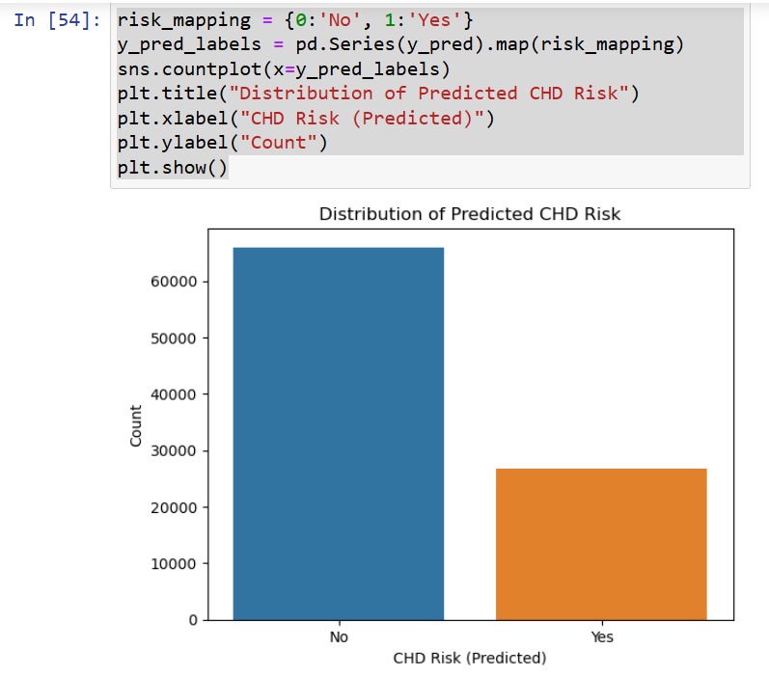
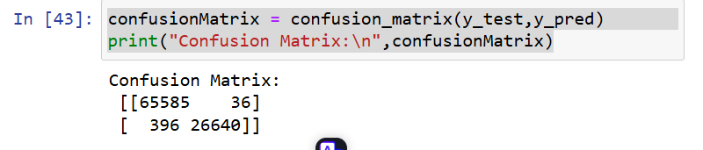
Proposed Solution
Visual Elements:
A bar plot to visualize the distribution of the predicted CHD risk labels
A confusion matrix to show the Correct and Incorrect Predictions

Slide 6
System Approach
System requirements
HardWare:
CPU:
Processor: AMD Ryzen 7 4800H or Intel equivalent (e.g., Intel Core i7)
Cores: At least 8 cores for efficient multitasking and faster processing of large datasets
GPU:
Graphics Card: NVIDIA GeForce GTX 1660 Ti or better
VRAM: At least 6 GB of dedicated VRAM for handling larger models and datasets, especially if using deep learning models like LSTM
RAM:
Memory: At least 16 GB of RAM for handling large datasets and running multiple applications simultaneously
Recommended: 32 GB for smoother performance with large datasets and more complex models
Storage:
SSD: At least 512 GB SSD for fast read/write speeds and efficient data handling
Recommended: 1 TB SSD to store large datasets and for better overall performance
Software:
Operating System:
OS: Windows 10/11 or a Linux distribution (e.g., Ubuntu)
Python Environment:
Python Version: Python 3.7 or higher
IDE: Jupyter Notebook, VS Code, PyCharm

Slide 7
System Approach
Library required to build the model:
numpy
pandas
sklearn
matplotlib.pyplot
seaborn

Slide 8
Algorithm & Deployment
Algorithm Selection:
Chosen Algorithm: Random Forest Classifier
Justification: The Random Forest algorithm is chosen due to its robustness and ability to handle high-dimensional data, making it suitable for predicting the 10-year risk of CHD. It can manage both categorical and numerical variables effectively, and its ensemble nature reduces the risk of overfitting, providing reliable predictions..
Data Input:
Input Features:
Demographic Factors: Age, Sex
Behavioral Factors: Smoking History, Exercise Frequency, Alcohol Consumption, Diet (Fruit and Green Vegetables Consumption, Fried Potato Consumption)
Medical Factors: BMI, Heart Disease History, Diabetes, General Health, Depression, Arthritis, Skin Cancer, Other Cancer
Custom Features: Risk Score, Age Category (created during feature engineering)

Slide 9
Algorithm & Deployment
Training Process:
Training Methodology:
Data Split: The dataset is split into training (70%) and testing (30%) sets.
Training: The Random Forest Classifier is trained on the training set, using 50 estimators (trees).
Techniques:
Cross-Validation: Used to tune hyperparameters and ensure the model’s generalization capability.
Hyperparameter Tuning: Adjusting parameters such as the number of trees, max depth, and minimum samples split to optimize the model's performance..
Prediction Process:
Prediction Methodology:
Trained Model Usage: The trained Random Forest model makes predictions on new patient data.
Real-Time Data Inputs: In a deployed environment, real-time patient data (demographic, behavioral, medical) is fed into the model to predict CHD risk.
Output: The model outputs a binary prediction (0 for 'No CHD Risk', 1 for 'CHD Risk') along with a probability score indicating the confidence of the prediction.

Slide 10
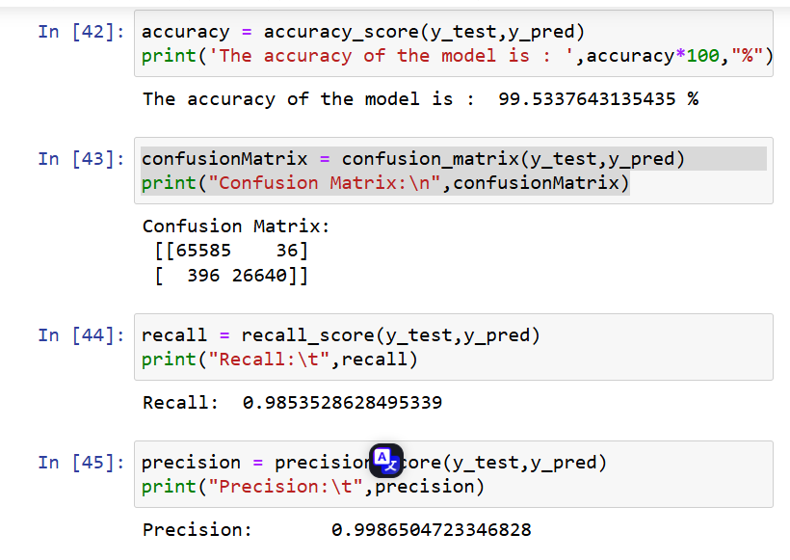
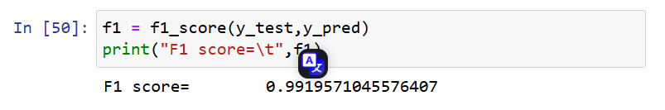
Result

Slide 11
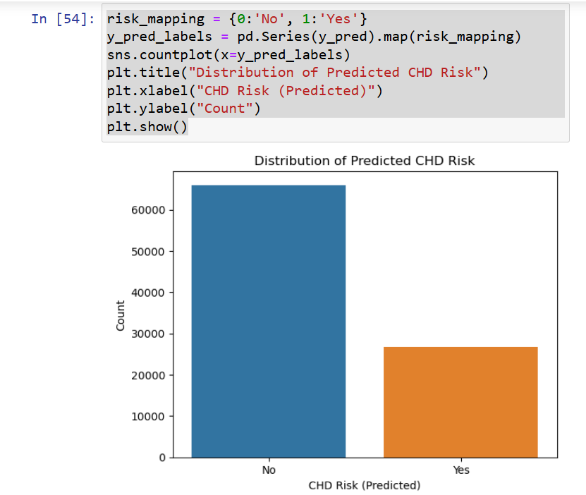
Result

Slide 12
Conclusion
Findings:
The Random Forest Classifier achieved an accuracy of 99.53% in predicting the 10-year risk of coronary heart disease (CHD).
The model's performance metrics are impressive:
Recall: 98.53%
Precision: 99.87%
F1 Score: 99.20%
These metrics indicate a highly reliable model that can effectively distinguish between patients with and without a high risk of CHD.
Effectiveness:
High Accuracy: The model's high accuracy and precision demonstrate its effectiveness in predicting CHD risk, which is critical for early intervention and preventive measures.
Robustness: The use of the Random Forest algorithm ensures robustness against overfitting and manages both categorical and numerical data efficiently.
Comprehensive Feature Set: By incorporating a wide range of demographic, behavioral, and medical features, the model captures the multifactorial nature of CHD risk.

Slide 13
Conclusion
Challenges Encountered:
Data Imbalance: Managing imbalanced data was a challenge, as the number of positive cases (CHD risk) was lower compared to negative cases.
Solution: Techniques like oversampling, undersampling, or using class weights were considered to address this issue.
Feature Engineering: Extracting relevant features and ensuring their quality required significant preprocessing and domain knowledge.
Computational Resources: Training the model, especially with large datasets and hyperparameter tuning, demanded substantial computational power.
Potential Improvements:
Model Optimization: Further tuning of hyperparameters and experimenting with other algorithms like Gradient Boosting or Neural Networks could potentially improve performance.
Feature Enrichment: Including more features, such as genetic factors or detailed lifestyle data, might enhance predictive power.
Real-Time Implementation: Developing a real-time prediction system with continuous learning capabilities to adapt to new data and trends.

Slide 14
Future scope
Expanding the System to Cover Multiple Cities or Regions:
Geographical Data Integration: Incorporating location-based data (e.g., pollution levels, availability of healthcare services) can help tailor risk assessments to specific regions.
Scalability: Ensuring the system can handle large datasets from multiple regions through distributed computing frameworks like Apache Spark.
Local Health Data: Including data on local health trends, lifestyle factors, and demographic information to enhance the relevance and accuracy of predictions for different areas.
Advanced Machine Learning Techniques:
Deep Learning: Utilizing deep learning models, such as convolutional neural networks (CNNs) for image data (e.g., radiographs) or recurrent neural networks (RNNs) for time-series data (e.g., heart rate monitoring), can enhance predictive capabilities.
Federated Learning: Implementing federated learning can enable the model to learn from data distributed across multiple devices or locations without the need to centralize data, thereby ensuring privacy and security.
Explainable AI (XAI): Incorporating explainable AI techniques to make the model's predictions more interpretable, helping healthcare professionals understand the basis of risk assessments and make informed decisions.

Slide 15
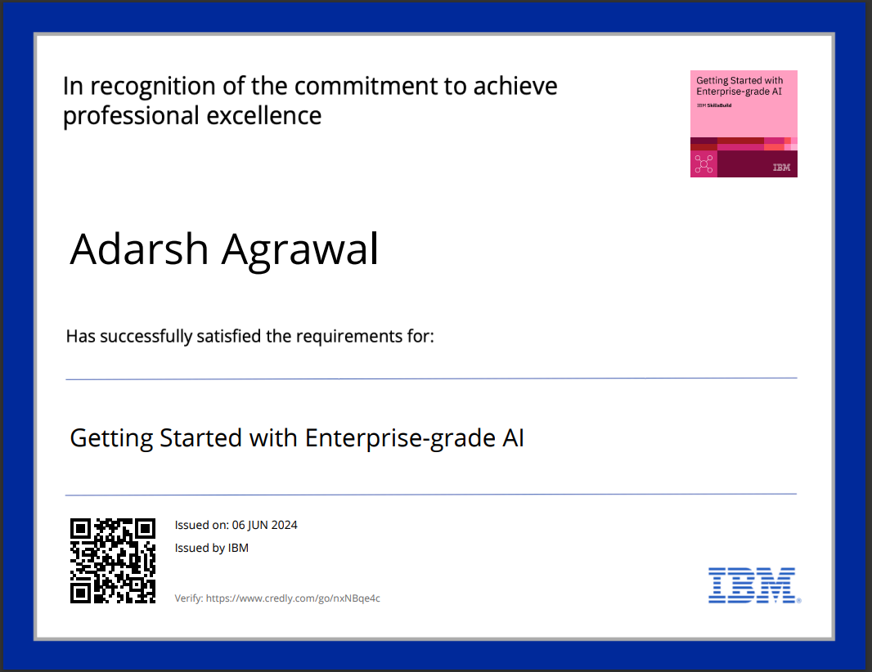
Course Certificate 1

Slide 16
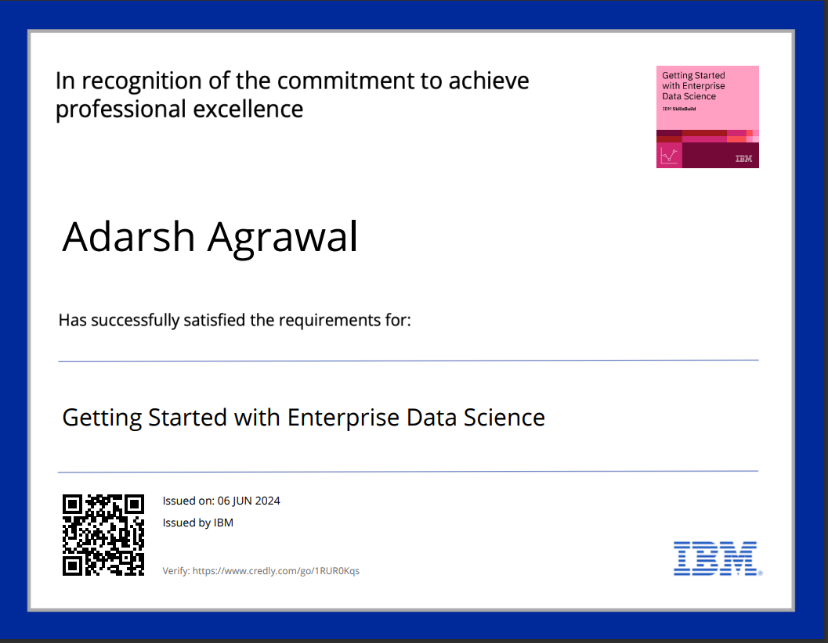
Course Certificate 2

Slide 17
References
Dataset : https://drive.google.com/file/d/11OKBDav2A8SDbAo1HPBHIcL7teTj8Qr_/view?usp=sharing
ChatGPT : https://chatgpt.com/share/78db4acc-aacc-46d4-b726-d14eb277e7c7
Github Link: https://github.com/Silent-ADARSH/Cardiovascular-Risk-Prediction

Slide 18
Project link :
https://github.com/Silent-ADARSH/Cardiovascular-Risk-Prediction
https://drive.google.com/drive/folders/1Ma1Yxg7CDt9b4_4GWC5ae8wO-dR2VmOD?usp=sharing

Slide 19
THANK YOU

